Slide 1


COMP4026 – Presentation
Reece Cripps

Slide 2


Project Overview
Comparing Machine learning and Mathematical Techniques on the cryptocurrency market
4 different methods (2 ML, 2 Math)
4 different coins (Bitcoin, Ethereum, Litecoin, LoopRing)

Slide 3
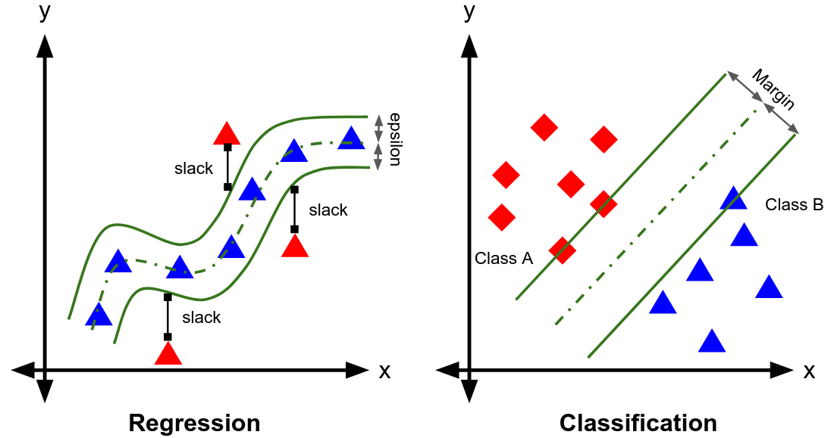
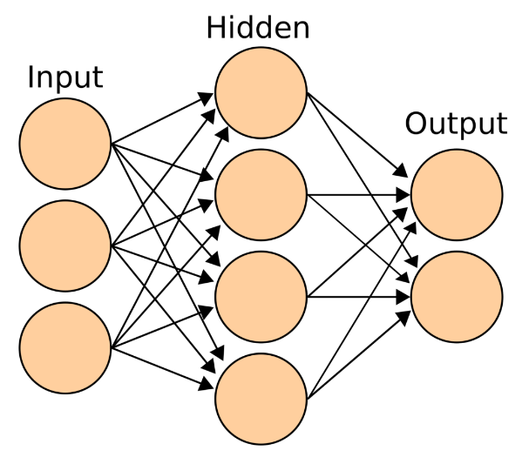
Machine Learning methods used
Support Vector Machine
Decision Boundary and support vectors used
to decide where the point lies.
Artificial Neural Network
Input passes to the hidden layer that performs
an activation function and then passes to the output
or another hidden layer
Notes:
Support Vector Machines (SVM) are a type of supervised machine learning technique effective for both classification and regression.
In classification SVMs use a decision boundary (hyperplane) and takes some points as support vectors to work out where a new point would belong
Artificial Neural Networks (ANN) are a type of deep learning algorithm. The way they work is modelled after a human brain, with neurons sending signals to each other.
A neural network is composed of an input layer, some series of hidden layers and then an output layer (as seen from the image)
The input layer is a 1:1 ratio with the number of features in the problem with an additional node acting as a bias. The input layer passes data to the hidden layer in a fully connected way
The hidden layer performs a type of activation function (set in the code) that either links to another hidden layer or links to the output nodes. I’ve used RELU (rectified linear unit)

Slide 4
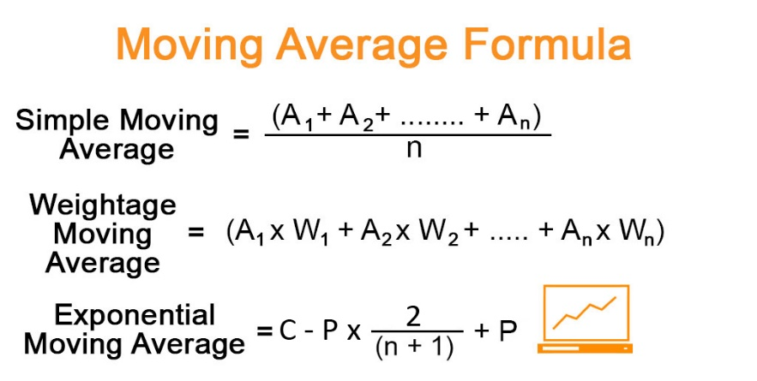
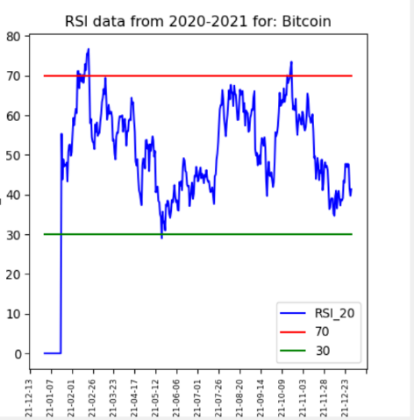
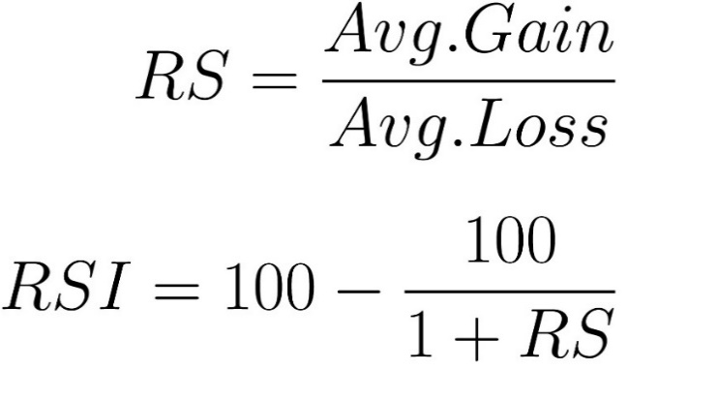
Mathematical Techniques Used
Moving Average
Two lines (longer average and a shorter average)
Longer > Shorter = Sell
Shorter > Longer = Buy
Relative Strength Index
Sell line (red) means overbought
Buy line (green) means oversold
Notes:
The moving average strategy is a popular mathematical technique used amongst traders. There are many distinct types of moving averages that are calculated in different ways.
For my project I chose the simple moving average which uses a 5 day average as the short line and a 10 day average as the longer line.
When the short average passes above the long average then you buy the asset and sell if the longer line passes above the shorter line.
The relative strength index is another common mathematical indicator used by traders.
This works by taking a relative strength (RS) which is calculated by the assets average gain divided by average losses.
This relative strength is then standardized from a value between 1 and 100 resulting in the relative strength index.
This trading technique works by using the buy and sell lines (green and red respectively).
If the RSI falls above the red line then the trading algorithm will sell the asset.

Slide 5
Tests Carried Out
3 Trading scenarios – Past Bull run 2018 – 2021
Past market crash 2021 – 2022
Live test - Bitcoin – 09/08 – 12/08, Ethereum – 11/08 - 14/08, Litecoin – 22/08 – 25/08, LoopRing – 25/08 – 28/08
For the past data the ML methods predicted the price and got an accuracy too.
Notes:
I tested these trading bots on 3 different scenarios:
2018 – 2021 – This was to simulate a bull run (where the market is on the rise)
2021- 2022 – To simulate a bear run (market crash)
Live – To test how the methods reacted based on unknown information
The machine learning methods were trained on previous data and then tested on the same as the mathematical methods.

Slide 6
Live Demo
Notes:
2018 run
2022 run
Show live data

Slide 7
Results 2018 – 2021
The machine learning strategies outperformed the mathematical ones.
The SVM bot made 204 times more profit than RSI.
SVM outperformed ANN – Higher prediction accuracy (second graph)
LoopRing was the most profitable asset for 3/4 of the trading techniques
Profits | Bitcoin | Ethereum | Litecoin | LoopRing | Total
Hold profit | $312.73 | $2014.69 | $94.57 | $5378.90 | $7800.89
Hold percentage profit | 62.55% | 402.94% | 18.91% | 1075.78% | 1560.18%
Notes:
As expected, the machine learning strategies outperformed the mathematical ones.
The bar chart shows how each of these strategies compared in terms on total profit.
As shown by the graph, RSI made a miniscule amount of profit in comparison to SVM ($3354.59 compared to $684,531.35)
The hold profit suggests that LoopRing was the most volatile as it made over double of any other asset available.
This coin has a far smaller market capacity compared to bitcoin and so we can see that these trading technologies will benefit from a faster growing coin in a bull run.

Slide 8
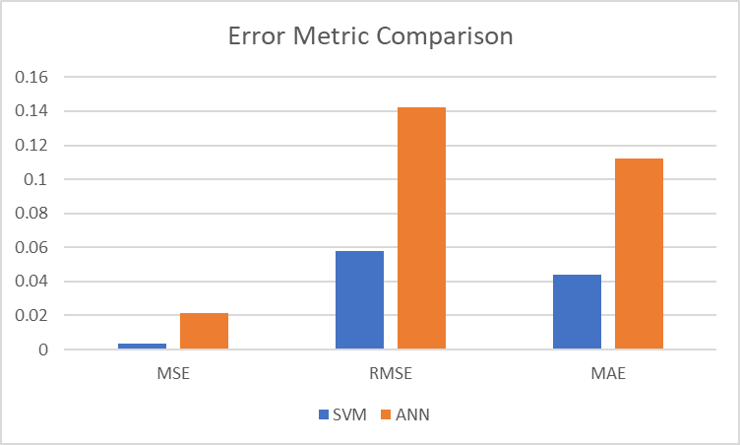
Results 2021 - 2022
market crashed dramatically with over 50% losses on all assets tested
SVM again coming out on top with $68917 profit
RSI lost money ($63.71) but not as much as the hold profit
Profits | Bitcoin | Ethereum | Litecoin | LoopRing | Total
Hold profit | $ -290.63 | $ -258.69 | $ -284.93 | $ -379.85 | $-1214.10
Hold percentage profit | -58.13% | -51.74% | -56.99% | -75.97% | -242.83%
Notes:
In this era of cryptocurrency, the market crashed dramatically with over 50% losses on all assets tested.
I thought this would be a good test to see how each technique faired with a market crash.
SVM again coming out on top with $29,629.78 more profit than ANN in second.
Again, looking at the error metrics we can see that this time all error values were far lower than 2018-2021 so the trading bots were more accurate with their predictions.
However, as the market was crashing they were unable to make profit, instead they were able to avoid losing money in the downfall whilst knowing the optimal entry point and best point to sell again before another crash.
MA managed to outperform RSI again. This is because the moving average will buy once the price starts to recover and sell when the reverse occurs.
Meaning that it is able to avoid the big crashes, but it is not as reactive as the machine learning techniques.

Slide 9
Results Live
Currently, the market is the lowest it has been since 2020
The majority of bots managed to make profit on almost all of the assets
Hold profit lost over 10% on LoopRing
Same pattern as previous tests
RSI lost more than the total hold profit
Notes:
Currently, the market is the lowest it has been since 2020 meaning that these live tests might not show as much profit as it normally would when the market isn’t crashing.
However, I was still surprised by the outcome of the tests.
The majority of bots managed to make profit on almost all of the assets despite some of the prices falling or barely changing at all.
Due to the API call request limitations I had to run the coins on different dates, but every trading bot was run at the same time.
The control variable (Hold profit) managed to make profit on 3 of the 4 assets and lost over 10% on LoopRing.
The same pattern followed previous tests with SVM outperforming all bots and RSI making a loss.

Slide 10
Conclusions/Future Work
My project successfully displays a comparison between the 4 different methods.
Clearly showing that the machine learning approaches outperform the mathematical ones
However, the mathematical ones are far simpler and require far less computational power and previous knowledge.
For future work I recommend that researchers look into more methods to compare.
Also, more recent coins and data (far smaller coins than the ones I’ve used)
Notes:
To conclude, my project was able to successfully create four different types of trading bots of two different sub methods (machine learning and mathematical).
The main aim of my project was to be able to compare the four types of technical strategies in the cryptocurrency market.
I was able to achieve this and found that the machine learning approaches were far superior to the mathematical ones in all three trading scenarios.
All trading bots performed extremely well during the uptrend of 2018-2021 (as expected)
but then the machine learning bots also performed far better than expected in the market crash of 2021-2022.
In terms of the live trading, I was not expecting a large amount of profit as this was only being run for a couple of days.
However, to achieve higher than the holding profit on all coins was exceptional for the ANN and SVM trading bot. Also, the moving average achieving higher in most of the coins is also impressive.
I feel like my project has improved the current research frontier because there was no comparison between mathematical methods and machine learning techniques.
My project shows a clear evaluation of all these methods and which method excels.
There are many further improvements that could be made and other types of research that can be done in this area.
I would recommend that other researchers delve into other types of machine learning approaches as well as other mathematical approaches.
Also, I recommend that other researchers look at more recent coin prices and data, it would be interesting to see how these methods react in a highly volatile environment.

Slide 11
Thanks For Listening
Any questions?

